Slide 1
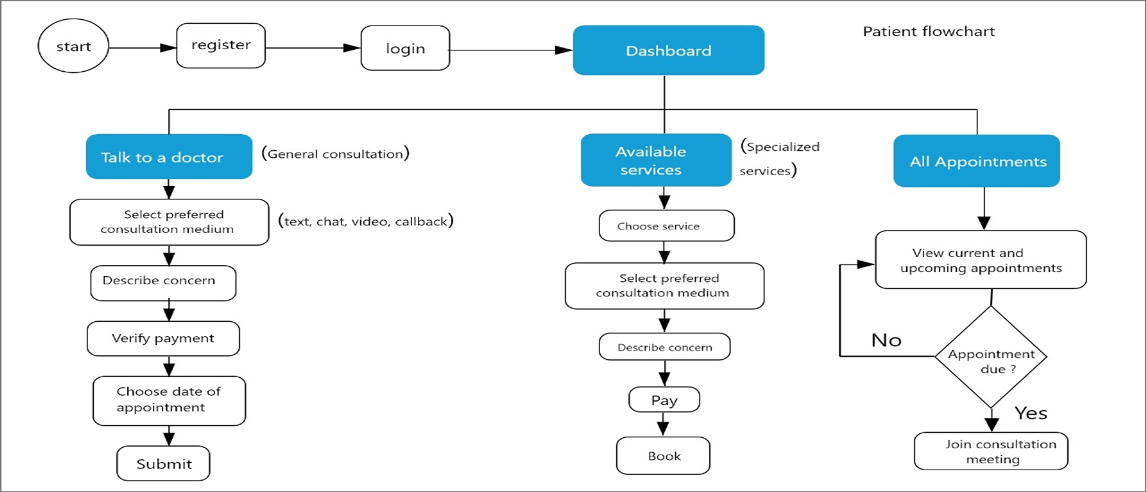
Telemedicine Attempts through Inhouse Development: Feats & Challenges
Developers(s): Timothy Makori, Oliver Mulwa, Simon Ngaruiya, Collins Muigai
Other Team Members: Kevin Gaitho, Francis Gachau, Emmanuel Njoroge
With the rapid advancement of technology, an increasing number of patients are embracing online healthcare services. To meet this rising demand, telemedicine is experiencing significant growth. However, implementing effective telemedicine presents complex challenges, requiring a seamless integration of robust infrastructure and well-defined processes to ensure its success.
Details/ Considerations
Problem Statement
Key Drivers
Right Technology Stack
Laravel/Web RTC/Vue JS/Tailwind
Telemedicine, while transformative, requires a sophisticated blend of infrastructure, security, and streamlined workflows to succeed. To address these challenges and meet patient expectations at Kijabe Hospital, a custom telemedicine platform built using the Laravel PHP framework and DevOps practices offers a scalable, secure, and efficient solution. Adoption of this platform could bridge the need for telemedicine solutions in the market
Background
Teleconferencing Equipment & Noise Cancellation Earphones
Marketing
Free & Paid Marketing
Target State: SMART Goal
Develop and deploy a telemedicine platform using Laravel and DevOps practices to enable online consultations, appointment scheduling, and real-time patient data access for Kijabe Hospital.
Training
Unified Modeling Language Blueprint for Kijabe Hospital Telemedicine System
Support
Market Penetration & Sustainability
Expand solution to ensure it is more robust.
Expand the service offerings to telepharmacy and telediganostics
Engage aggressive marketing and brand ambassadors
Provide real time feedback and support
Track data
Analysis
Frontend: Vue.js with Tailwind CSS used for patient and doctor interfaces.
Backend: Laravel 11 handling the business logic, authentication, and WebRTC Signaling
Realtime Communication: WebRTC for video/audio, with Laravel Echo and Pusher for notifications and signaling.
Database:
Primary Database: MySQL for patient specific data eg patient self registration and appointment
Remote Database: Planned integration to SmartCare database through remote SQLSRV
Deployment: Local environment, Linux Server
Laravel is scalable and will support growing patient demand as proper marketing for the service line ensues. The experience in the first quarter of 2025 is also spelling out key drivers for the already robust platform to support the telemedicine business.
Citations
Adapt. (2024, February 12). Leveraging Laravel for Innovative Healthcare Solutions. Adapt Digital. https://adapt.digital/insights/leveraging-laravel-for-innovative-healthcare-solutions

