Slide 1

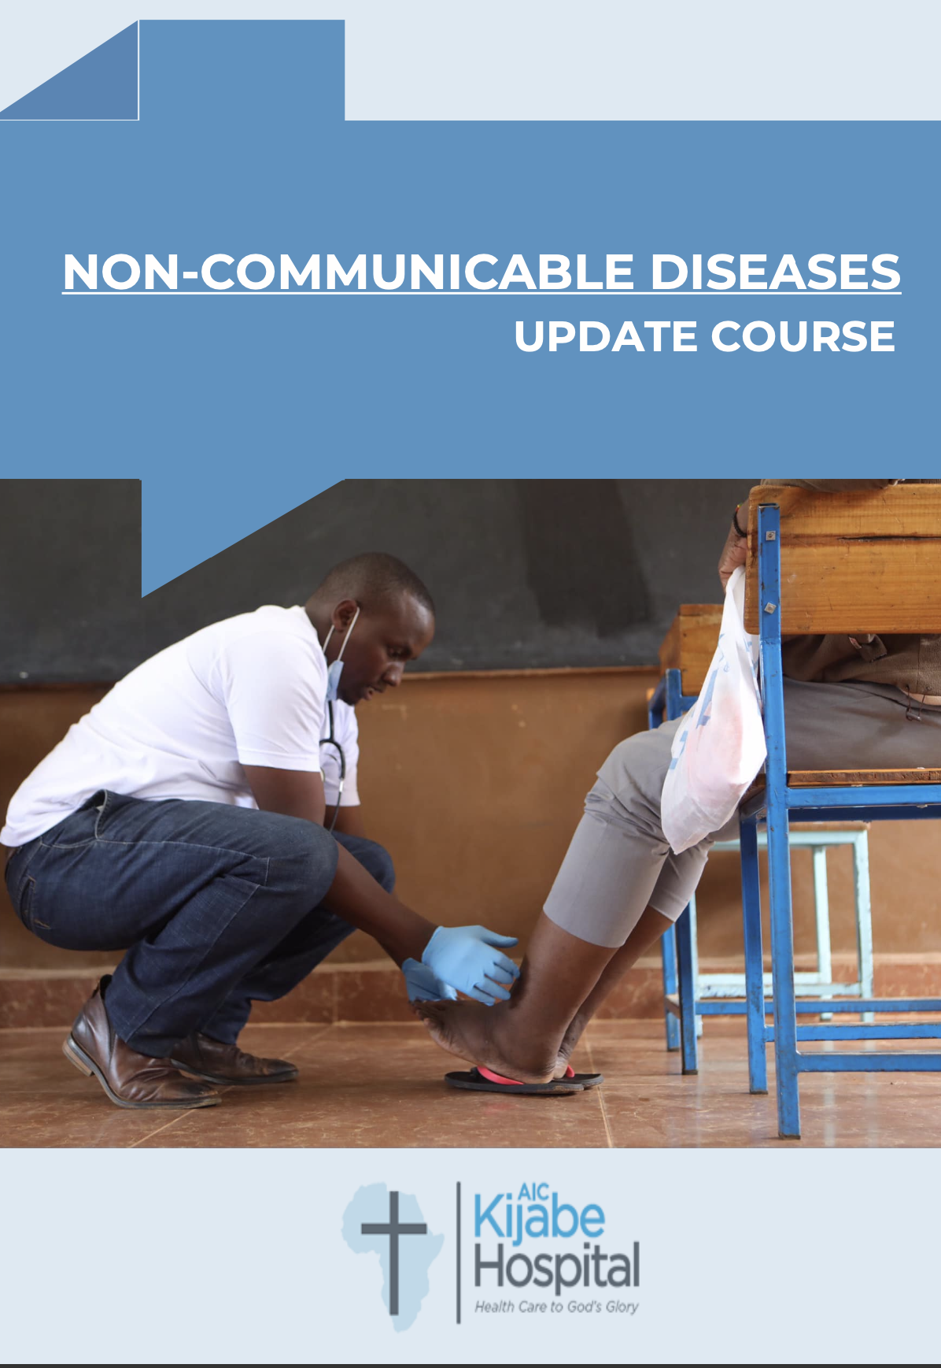
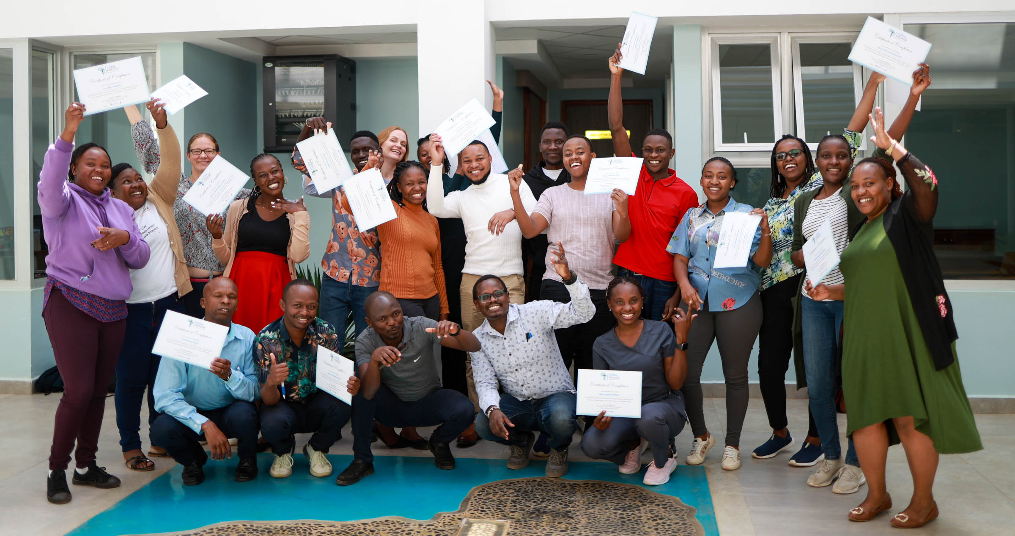
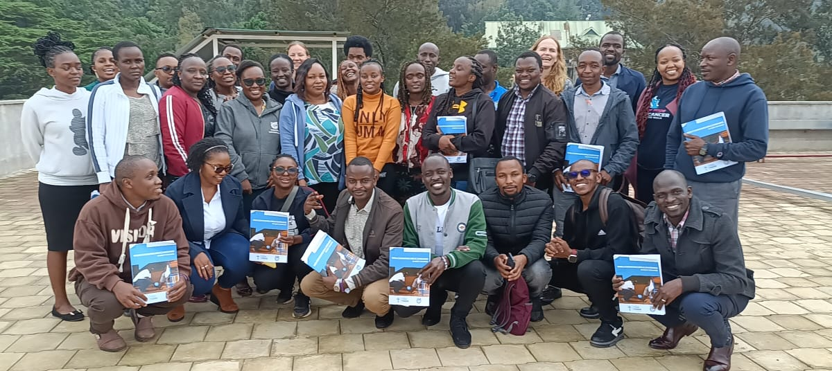
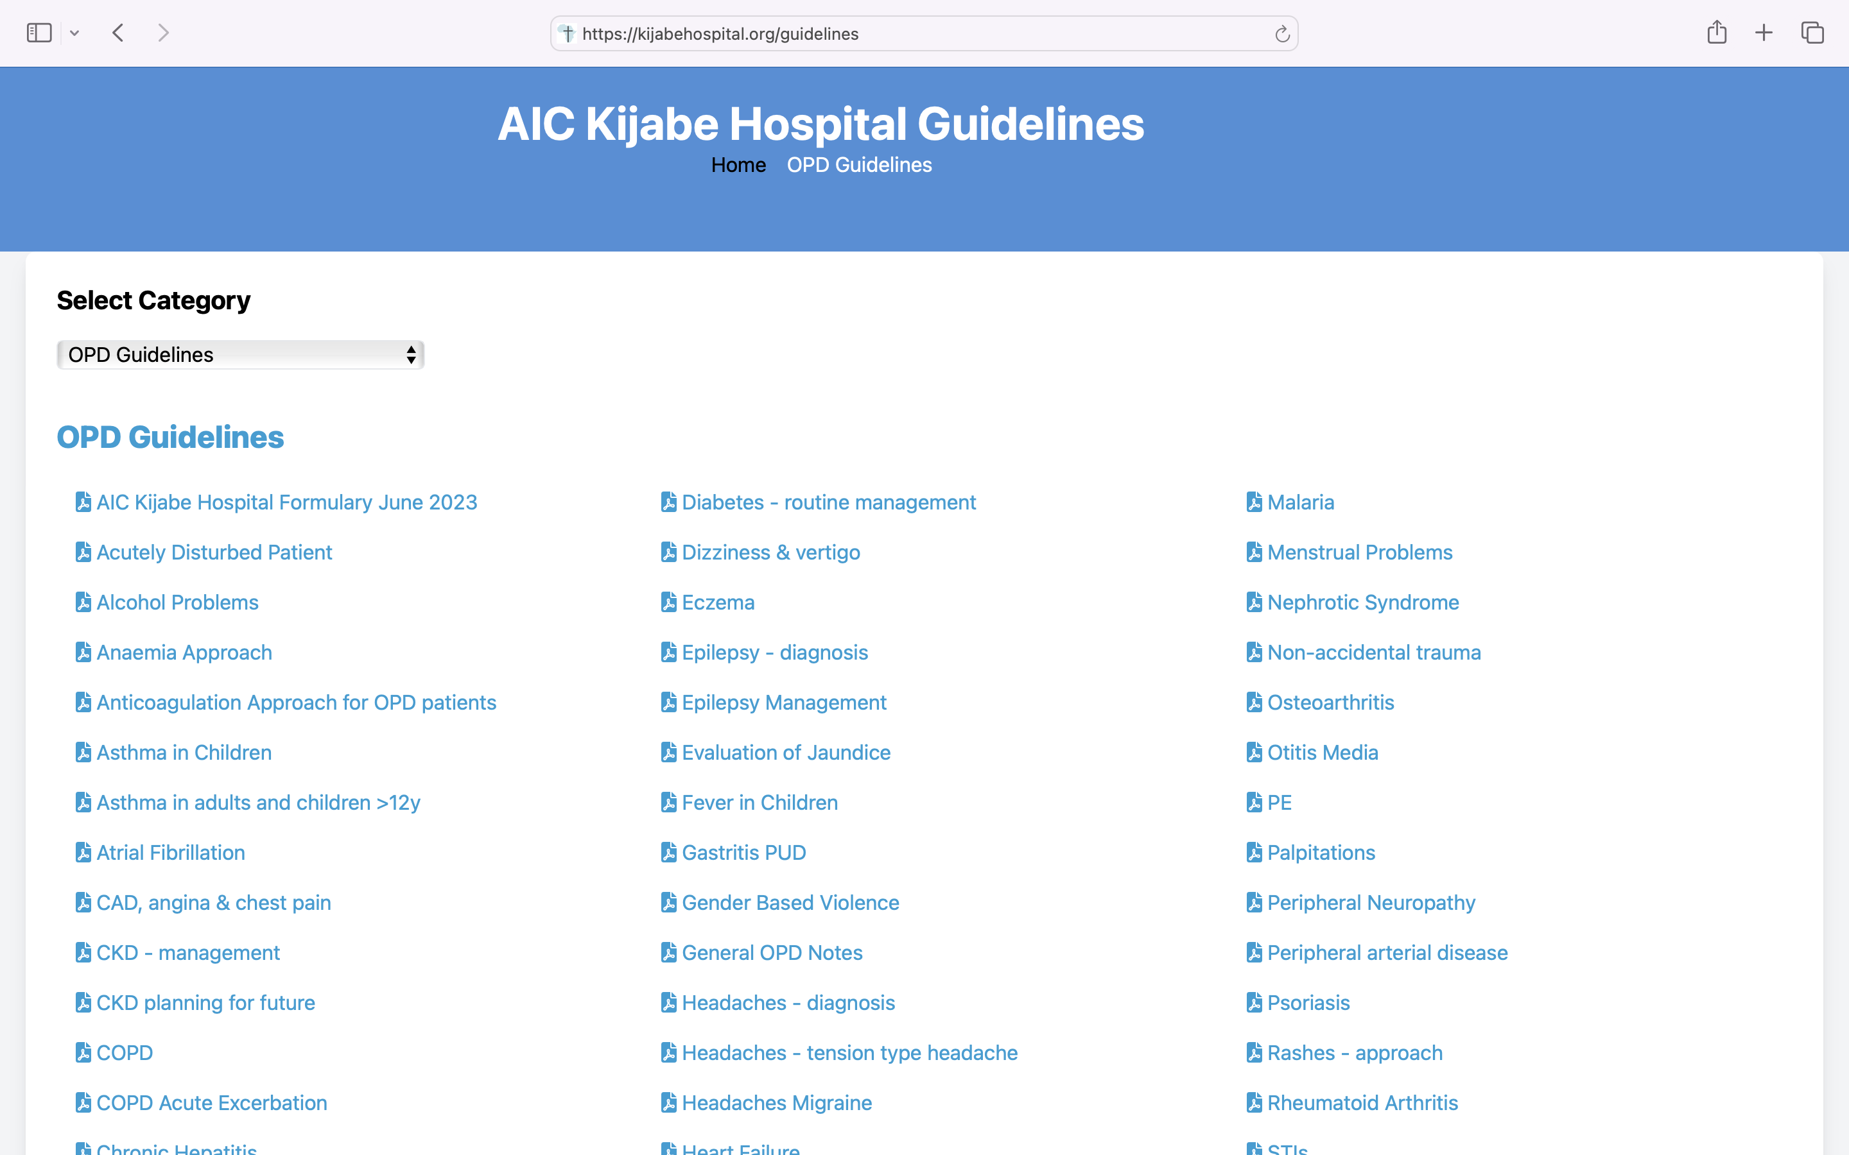

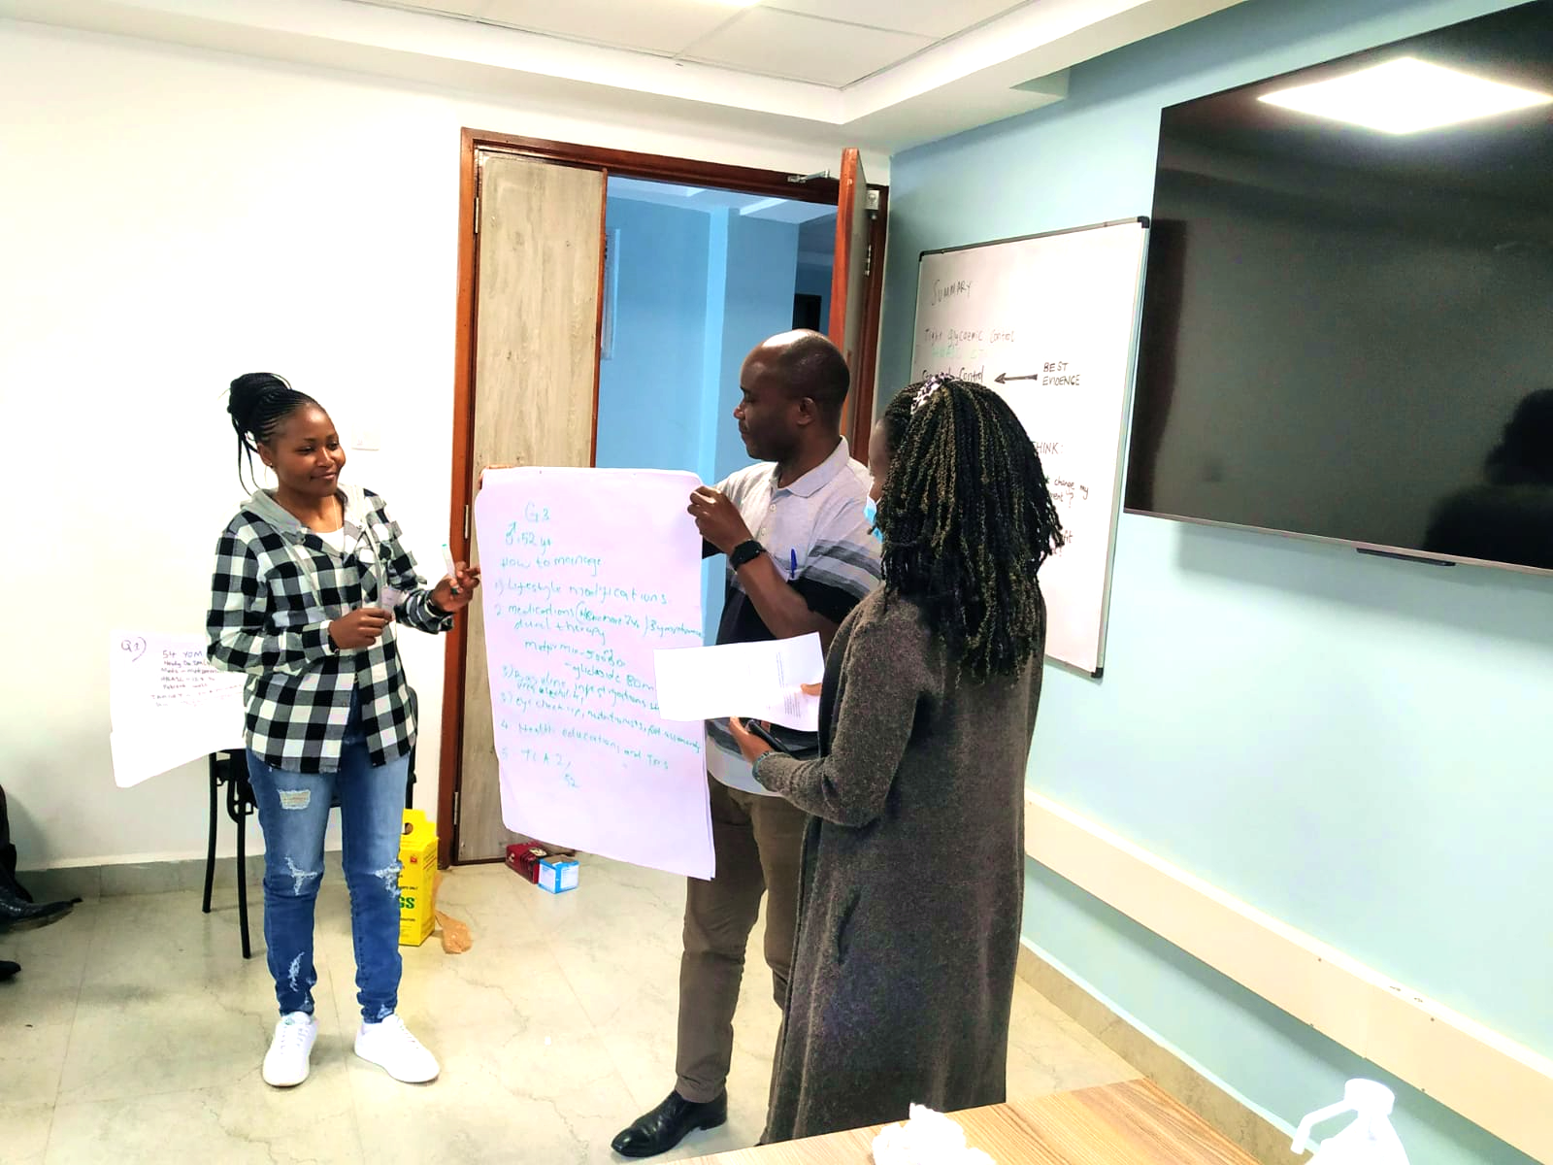
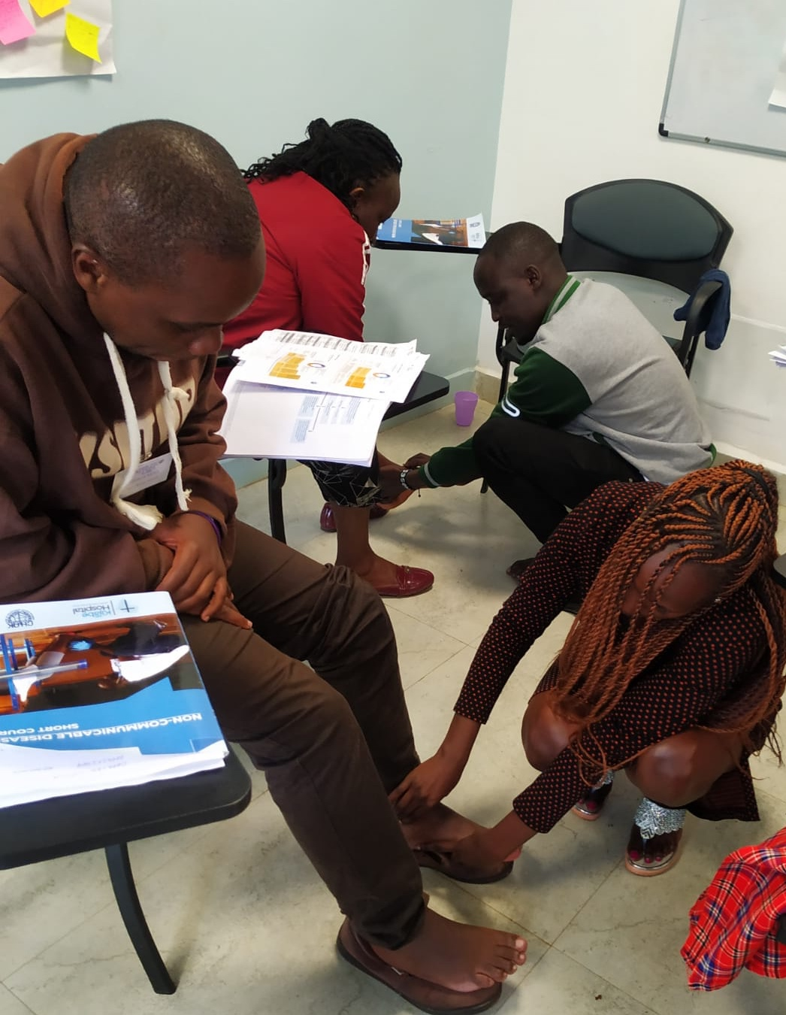
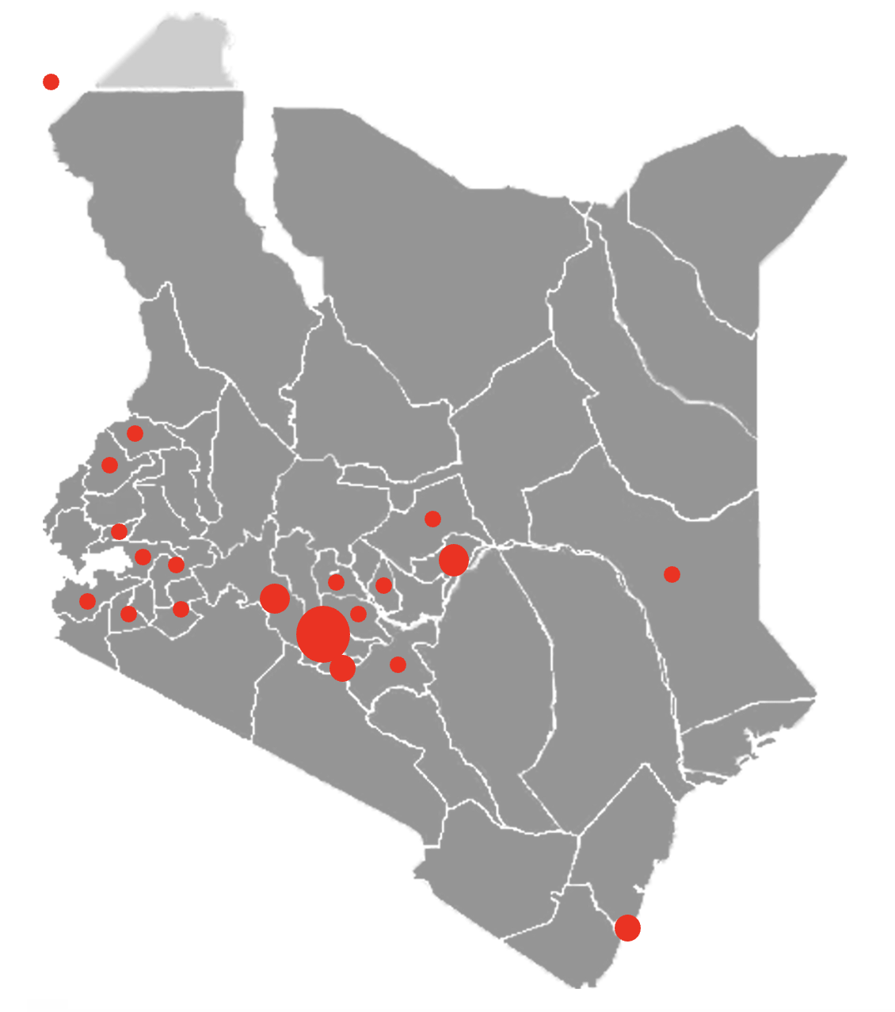
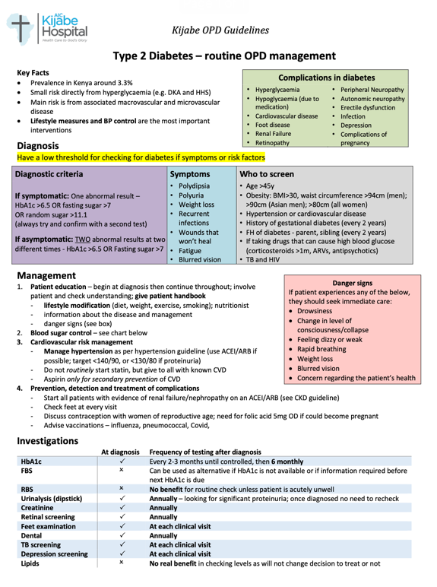
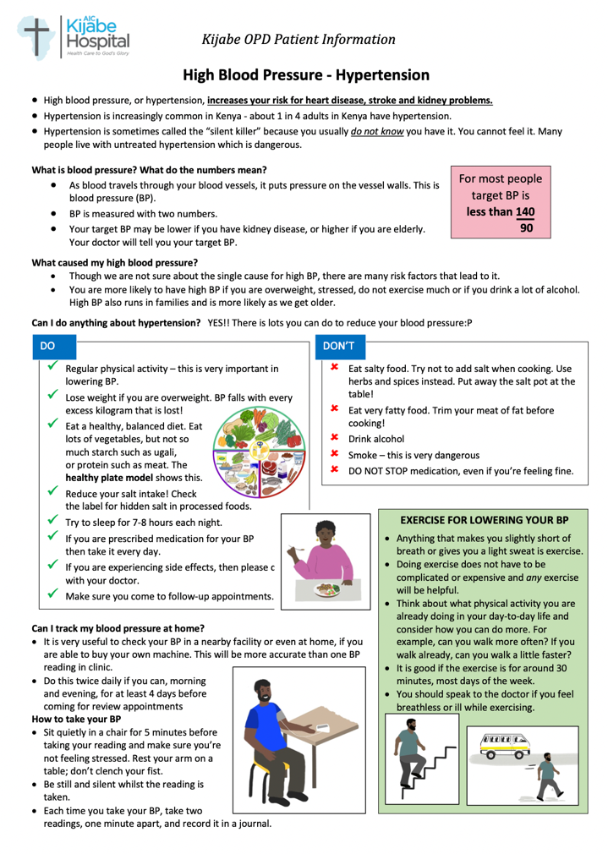
NCD course development
Dr Kaya Belknap, Dr Katy Linley, Harriet Wanjiru, Irene Muthoni, Emmanuel Ndeto, Elijah Mungathia
Background
Non-communicable diseases (NCDs) are the number one cause of mortality and morbidity worldwide.¹ Low- and middle- income countries are disproportionately affected, with 80% of global NCD deaths and 90% of those deaths being premature.² In Kenya NCDs are responsible for more than 50% of hospital admissions and 39% of all deaths annually.^{3,4}
The family medicine team at AIC Kijabe Hospital have established a broad range of concise, evidence-based guidelines to provide a preferred standard of care for mid-level providers. Currently 93 guidelines and patient information leaflets found at: https://kijabehospital.org/guidelines
In 2022, hypertension & diabetes were the most viewed guidelines, consistent with the rise of NCDs but the lack of quality and relevant resources in our setting.
In Kenya, there are a large number of midlevel providers and junior doctors carrying out front-line care with minimal supervision and no ongoing training in NCD care. We recognised the need for a short course training in NCDs.
Methods
In July 2022 we designed a short-course which focused on diabetes. This course was then adapted to cover a range of NCDs and is being run quarterly at AIC Kijabe Hospital.
The course include cardiovascular diseases, diabetes, chronic lung disease, cancer, epilepsy and common mental health problems. We look at common risk factors across NCDs and discuss practical ways to manage them. This includes a focus on people-centred care and training in motivational interviewing.
We call this an update course as we are not trying to teach the subjects from scratch, but assuming previous relevant knowledge and experience. We present up-to-date evidence and tools relevant to everyday practice, moving through topics quickly with a team of facilitators.
We base much of the teaching
around case studies and we
use other evidence-based
teaching methods to make
this interactive, varied and
engaging to learners. We
use the Kijabe OPD
guidelines throughout the
course and a course handbook
has been developed which can be used in everyday work.
We have introduced quality improvement methods as part of the course and with action points being one of the ways we track change from the course
Findings
The course has run seven times so far, training a total of 128 health care professionals. This includes all clinicians in Kijabe OPD and all from Marira satellite clinic. We have seen improvement in adherence to guidelines. Many attendees have come
from other
parts of
Kenya with
much
positive
feedback
showing
changes
to working
practice.
“We’ve been able to do diabetic foot exam for all our patients coming through the NCD clinic and also in the wards…this also comes with doing most eye exams and dental assessment for inpatient” Dr Karin, Chogoria
“I did a CME and we implemented in our facility use of screening tools for mental health in our NCD clinic and vice versa - NCD screening in our mental illness clinic. I received good feedback concerning the availability of the Kijabe guidelines online and many thanks especially from clinicians” Audrey, Kenyenya Subcouty Hospital, Kisii
“Our NCD clinic is doing well, our NCD clients have increased, thanks to you and your team. The training was eye opening…… I incorporated some of the ideas in the DM booklet. And it's paying off. ” Charles, Equityafia, Kitale, Trans Nzoia County
Interpretation
This is an example of how primary care knowledge can be disseminated, and this course could be scaled up for greater impact. It also demonstrates AIC Kijabe Hospital’s leadership in the creation of strategic and visionary training programmes; providing opportunity for influence in this growing sphere, as well as a revenue stream for the hospital.
References
NCD alliance https://ncdalliance.org/why-ncds/NCDs
World Health Organization https://www.who.int/news-room/fact-sheets/detail/noncommunicable-diseases
Kenya National Strategy for the Prevention and Control of Non-Communicable Diseases. Nairobi,Kenya; 2015
Ministry of Health—Republic of Kenya. National Strategic Plan for the Prevention and Control of Non-Communicable Diseases 2021/22–2025/26. Nairobi, Kenya; 2021
Nairobi123, CC BY-SA 3.0, via Wikimedia Commons
Source of funding: none
Map showing where trainees have come from

